Slide 1
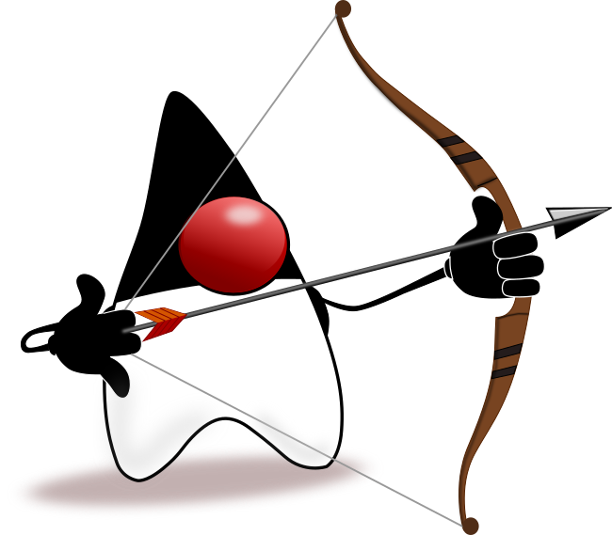


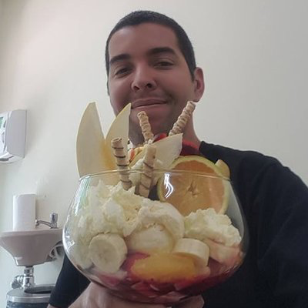
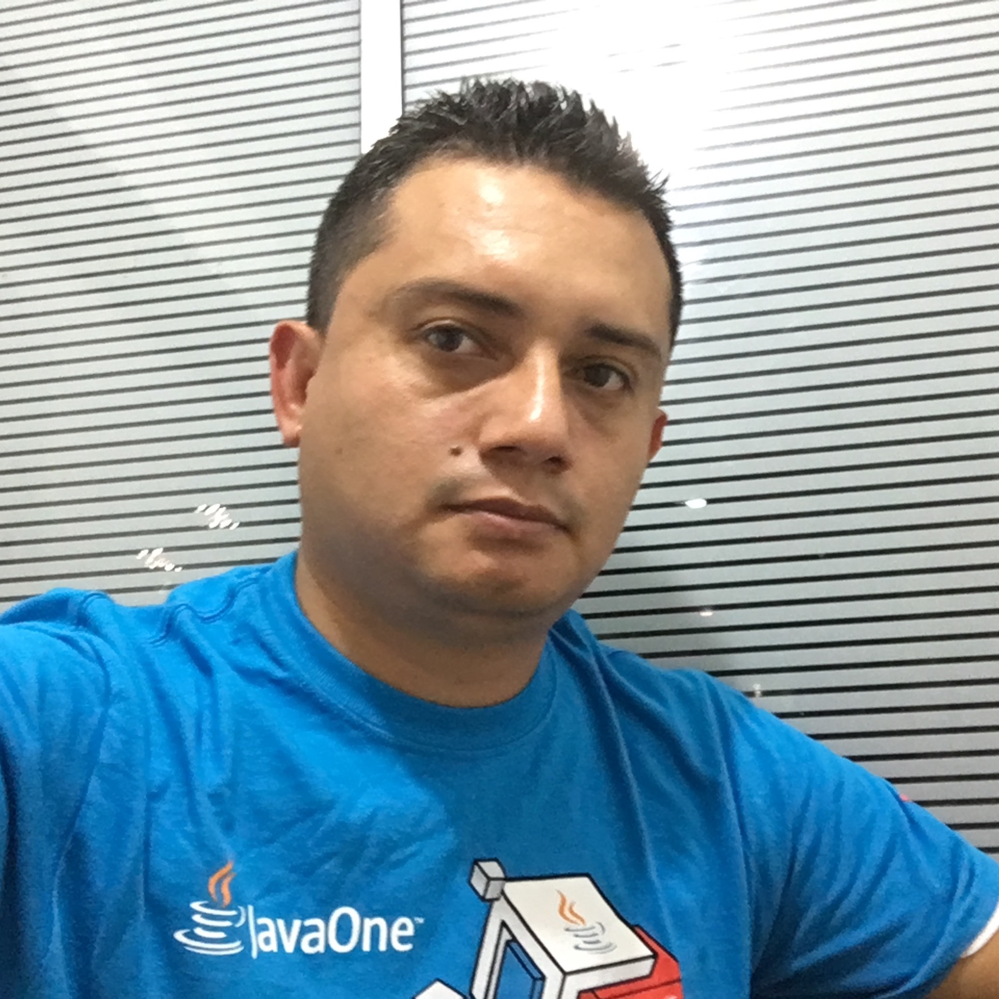
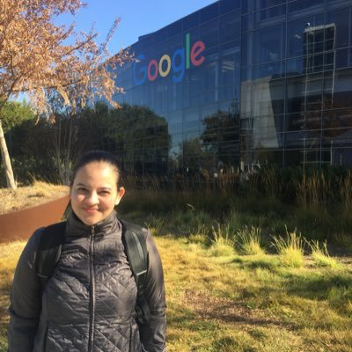
Eclipse JNoSQL
One API to Many NoSQL Databases
Jonathan Vila Lopez
Leonardo Lima
Otávio Santana
Hillmer Chona
Patricia Uribe

Slide 2
About the Speakers
Hillmer Chona
Medellin JUG Leader
Catholic University Luis Amigó - Colombia
Oracle Groundbreaker ambassador

Slide 3
About the Speakers
Jonathan Vila Lopez
Software developer for the last 25 years in different languages
Works for RedHat
Leader of Barcelona Java Users Group and JBCNConf
Very passionate about Java
Interested in particular on OSGi, Kubernetes, VR

Slide 4
About the Speakers
Leonardo Lima
Computer engineer, server & embedded sw developer
CTO at V2COM
Spec Lead – JSR363 – Units of Measurement
V2COM’s Representative at JCP Executive Committee

Slide 5
About the Speakers
Otávio Santana
Software engineer, Tomitribe
Java Champion, SouJava JUG Leader
Apache, Eclipse and OpenJDK Committer
Expert Group member in many JSRs
Representative at JCP EC for SouJava

Slide 6
About the Speakers
Patricia Uribe
Medellin JUG Leader
Catholic University Luis Amigó - Colombia

Slide 7
NoSQL (Not Only SQL)

Slide 8









What defines NoSQL databases?
No fixed data structure
Not an ACID, but a BASE
Five different types
Key/Value
Column Family
Document
Graph
Multi-Model

Slide 9
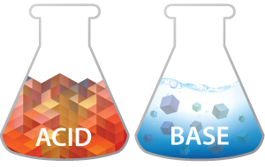
ACID x BASE
Atomicity,
Consistency,
Isolation,
Durability
Basically
Available,
Soft State,
Eventual consistency

Slide 10
Key/Value
AmazonDynamo
AmazonS3
Redis
Scalaris
Voldemort
Couchbase
Hazelcast
Apollo
Sun
Light
Music
Aphrodite
Love
Beauty
Ares
War
Notes:
Pense como um Map<Object, Object> -
Bucket = Tabela
Mais simples, mais rápido
Tipos especializados, como lista, economiza processamento e tráfico de rede

Slide 11
Column Family
Row key
Duty
Hbase
Cassandra
Scylla
Clouddata
SimpleDb
DynamoDB
{”Sun”, “Light”, ”Music”}
Apollo
Ares
Duty
Weapon
“War”
“Sword”
Kratos
SlainGods
13
Notes:
Document Collection == Table
Document = Tuplas JSON
SubDocument

Slide 12
Document
{ ”name”:”Diana”, ”father”:”Jupiter”, ”mother”:”Latona”, ”siblings”:{
”name”: ”Apollo” },
”godOf”: {”Hunt”} }
AmazonSimpleD
Apache CouchDB
Couchbase
MongoDB
Riak
Notes:
Document Collection == Table
Document = Tuplas JSON
SubDocument

Slide 13
Graph
Apollo
sibling
Neo4J
InfoGrid
Sones
HyperGraphDB
Ares
slain by
slew
slain by
slew
Kratos
Notes:
Document Collection == Table
Document = Tuplas JSON
SubDocument

Slide 14

Multi-model
OrientDB
graph, document
Couchbase
key-value, document
Elasticsearch
document, graph
ArangoDB
column family, graph, key-value
Notes:
Document Collection == Table
Document = Tuplas JSON
SubDocument

Slide 15
SQL -> NoSQL
SQL | Key-Value | Column Family | Document | Graph
Table | Bucket | Column Family | Collection
Row | Key/Value pair | Column | Document | Vertex
Column |  | Key/Value Pair | Key/Value Pair | Vertex/Edge properties
Relationship |  |  | Link | Edge
Notes:
Document Collection == Table
Document = Tuplas JSON
SubDocument

Slide 16
Scalability x Complexity
Key/Value
Column Family
Scalability
Document
Graph
Complexity
Notes:
Document Collection == Table
Document = Tuplas JSON
SubDocument

Slide 17
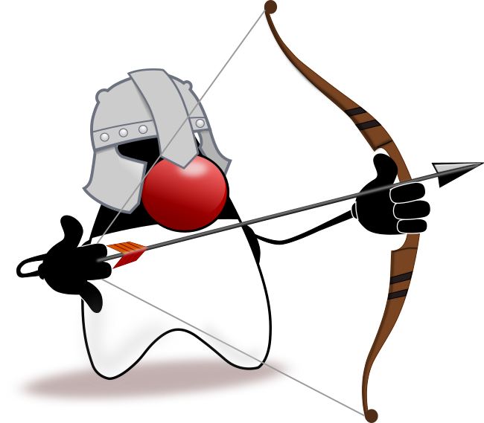
JNoSQL

Slide 18
What is JNoSQL?
DAO
Mapping API - Artemis
Communication API - Diana
No lock-in
Divide and conquer
Mapping
JNoSQL
Communication
Notes:
Document Collection == Table
Document = Tuplas JSON
SubDocument

Slide 19

Eclipse JNoSQL
Eclipse Foundation
Apache v2 + EPL 1.0
API to each NoSQL type
Configurable
Extensible
Mapping
Communication
Notes:
Document Collection == Table
Document = Tuplas JSON
SubDocument

Slide 20
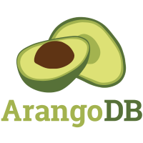



For example: for a Document DB…
BaseDocument baseDocument = new BaseDocument();
baseDocument.addAttribute(name, value);
Document document = new Document();
document.append(name, value);
JsonObject jsonObject = JsonObject.create();
jsonObject.put(name, value);
ODocument document = new ODocument(“collection”);
document.field(name, value);
Notes:
Document Collection == Table
Document = Tuplas JSON
SubDocument

Slide 21
… now with JNoSQL
DocumentEntity entity = DocumentEntity.of("documentCollection");
Document document = Document.of(name, value);
entity.add(document);
Notes:
Document Collection == Table
Document = Tuplas JSON
SubDocument

Slide 22
Names & Definitions
Configuration
Factory
Manager
Entity
Notes:
Document Collection == Table
Document = Tuplas JSON
SubDocument

Slide 23
Names & Definitions
ColumnConfiguration<?> condition = new DriverConfiguration();
try(ColumnFamilyManagerFactory managerFactory = condition.get()) {
ColumnFamilyManager entityManager = managerFactory.get(KEY_SPACE);
entityManager.insert(entity);
ColumnQuery select = select().from(COLUMN_FAMILY).where(eq(id)).build();
ColumnDeleteQuery delete = delete().from(COLUMN_FAMILY)
.where(eq(id)).build();
Optional<ColumnEntity> result = entityManager.singleResult(query);
entityManager.delete(delete);
}
Notes:
Document Collection == Table
Document = Tuplas JSON
SubDocument

Slide 24
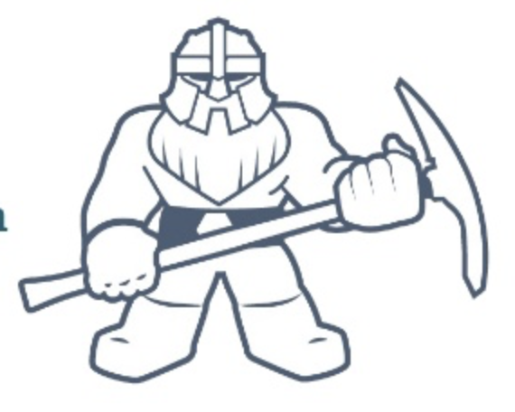
Eclipse JNoSQL - Artemis
Based on CDI and Diana
Heavy use of Annotations
Events on Create, Update, Delete
Bean Validation Support
Configurable and Extensible
“Query by Methods”
Notes:
Document Collection == Table
Document = Tuplas JSON
SubDocument

Slide 25
Names & Definitions
Annotated Entities
Template
Repository
Configuration
Notes:
Document Collection == Table
Document = Tuplas JSON
SubDocument

Slide 26
Annotaded Entities
@Entity(”god")
public class God {
@Column
private String name;
@Column
private Set<God> siblings;
…
}
MappedSuperclass
Entity
Column
Notes:
Document Collection == Table
Document = Tuplas JSON
SubDocument

Slide 27
Templates
import static DocumentQuery.select;
@Inject DocumentTemplate template;
God diana = God.builder().withName(“Diana”);
template.insert(diana);
template.update(diana);
DocumentQuery query = select().from(“god”).where(“name”).equals(“Diana”).build();
List<God> gods = template.select(query);
Notes:
Document Collection == Table
Document = Tuplas JSON
SubDocument

Slide 28
Repository
@Inject
@Database(DatabaseType.COLUMN)
private GodRepository godRepository;
@Inject
@Database(DatabaseType.KEY_VALUE)
private GodRepository godRepository;
Notes:
Document Collection == Table
Document = Tuplas JSON
SubDocument

Slide 29
Configuration
[ {
"description": "The couchbase document configuration",
"name": "document",
"provider": "org.jnosql.diana.couchbase.document.CouchbaseDocumentConfiguration",
"settings": {
"couchbase-host-1": "localhost",
"couchbase-user": "root",
"couchbase-password": "123456"
}
} ]
Notes:
Document Collection == Table
Document = Tuplas JSON
SubDocument

Slide 30
Configuration
@Inject
@ConfigurationUnit
private DocumentCollectionManagerFactory<?> entityManager;
Notes:
Document Collection == Table
Document = Tuplas JSON
SubDocument

Slide 31
Hands-On!
https://github.com/JNOSQL/oc1-hands-on-2018

Slide 32
Data model for the use cases
JUGs and JUG Members!
JUG
Name
City
Programming Languages
Country
JUG Member
Name
City
Programming Languages (name and skill level)
Notes:
Document Collection == Table
Document = Tuplas JSON
SubDocument

Slide 33
Use case #1 - Key/Value
Create a database to handle JUG information using Redis
Create, Retrieve and Update JUG information
Model once and reuse the model with different database
Notes:
Document Collection == Table
Document = Tuplas JSON
SubDocument

Slide 34
Use case #2 - Document
Implement some searches against a MongoDB
Search JUG members in a given city
Search JUG members of legal drinking age
Search JUGs in a region
Notes:
Document Collection == Table
Document = Tuplas JSON
SubDocument

Slide 35
Use case #3 - Graph
Implement recommendation searches against Neo4J
Find Beginner Java Users that know Advanced Java User(s).
Find Java Users in a given City
Recommend Advanced Java Users in the same City as a given User.
Notes:
Document Collection == Table
Document = Tuplas JSON
SubDocument

Slide 36
Thanks!
https://www.tomitribe.com/codeone/hol5998/

